Slide 1
Using USWDS critical checklists
to develop accessibility skills
across government teams
November 7–9, 2023
Dan Williams (Project Lead)
Amy Cole (Accessibility Specialist, Contractor)
Jacline Contrino (UX Researcher, Contractor)
United States Web Design System (USWDS)
Notes:
Thanks Beth and thank you to IAAF for inviting us here today to discuss something that's super important to the future of the U.S. Web Design System, the critical checklists we have in development right now.
I'm Dan Williams, he/him, Project Lead of USWDS. For anyone who can't see me, I've got dark hair and blue shirt and I'm coming to you today from my home in Portland, Oregon. Today I'm here with my colleagues Amy and Jacline to talk a bit about this idea of critical checklists, and how they can help develop accessibility skills across government teams.

Slide 2
What is the U.S. Web Design System?
USWDS is the design system for the federal government.
A design system...
Helps teams avoid reinventing the wheel when it comes to designing websites.
Helps provide a familiar and easy-to-use digital services across the federal government.
Helps provide accessible and usable solutions.
Notes:
So, just what is the U.S. Web Design System, or USWDS? Well, USWDS is the web design system for the federal government — and a design system is a tool to help designers and developers avoid reinventing the wheel when it comes to designing websites and digital services, by starting from common solutions.
Design systems help digital service teams across agencies and products, teams that might not have any working connection with each other, be connected by a common design language, in the service of common effective solutions and familiar and easy-to-use digital services across the federal government.
And, of course, building solutions that are broadly accessible and usable is a critical part of what makes a solution a good solution, so accessibility and usability are at the heart of what we deliver.

Slide 3
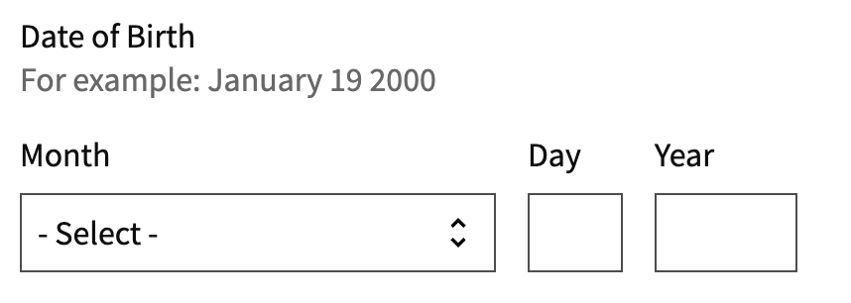
A common design language
Design principles
Interaction guidance (patterns)
Components
Palettes (design tokens)
Usability and accessibility guidance
Notes:
You can think of a design system as a kind of hardware store for building websites. So what are the types of things we stock? Here's what we have on the shelves:
Design principles or common values any team can share. Such as: start with real user needs, earn trust, embrace accessibility, promote continuity, and listen.
Interaction guidance — what we call patterns — or best practices for supporting the things people do again and again on our sites and services (like navigating a complex form, selecting a language for a service, or creating a user profile.)
Components, the building blocks of common user interactions. These are things like buttons, form inputs, alerts, tables, and headers. On the slide is our memorable date component, which is itself, made from two different components, a select (for the month) and two customized text input components (for the day and year).
And then components themselves are built from elements of common style: palettes of colors, type size, spacing units, and more that we call design tokens.
And all of this is tied together with comprehensive usability and accessibility guidance.

Slide 4
Who uses USWDS and what do they need?
Our users are...
All kinds of folks!
Developers, designers, content strategists, UXers, accessibility specialists, and more from federal agencies both large and small
They need...
A problem solving tool for design.
They need to be able to easily adopt and adapt our solutions to meet the needs of their agency and audience.
Reassurance.
They need peace of mind that solutions meet accessibility standards.
Notes:
Who are our users and what do they need?
Well, our users are all kinds of folks! We support developers, designers, content strategists, UXers, accessibility specialists, and more from federal agencies large and small.
What do our users need? At the most basic level, they're looking for a problem solving tool for design. They're trying to do more with their existing resources, and they need to be able to easily adopt and adapt our solutions to meet the needs of their agency, mission, and audience.
And a big part of what we want to provide for folks is reassurance that they're building from accessible solutions. And when they adopt and adapt USWDS solutions, they're also building things that are accessible and usable.

Slide 5
How might we provide more reassurance to our users?
Going beyond a simple badge...
How do we know a component is WCAG compliant.
How did we check it?
What were the results of those checks?
Notes:
We saw an opportunity to better document and communicate the accessibility of our components.
But when it comes to documenting the accessibility of our components, we think the answer isn't just a green checkmark or confirmation symbol like the funny badge on this slide that reads "Section 508 Inside!"
That would have some value, of course, but we think there's a next level of value, beyond the signal of conformance, that comes from how we made this assessment:
What accessibility and usability tests did we consider critical to the success of a component?
How did we check that the component is as accessible and usable, and what were the results of those checks?

Slide 6
Empowering anyone to test their own components
Ultimately, the most important moment of accessibility is in the final context where real people use these components. This is the place where testing matters most.
We can't do this ourselves, but we think we can make things easier for the folks that can.
Notes:
And if we do this right, we can not only document our conformance but empower anyone to test their own implementations of our components.
Because ultimately, the most important moment of accessibility is not on our website, but in the final website or application, in the final context where real people use these components.
We're not there to do that testing ourselves, but we think we can make things easier for the folks that can. And while we respect and appreciate accessibility expertise, we think that any member of a service team can and should have an accessibility centered mindset, and be better able to contribute to ongoing accessibility testing.

Slide 7
Support a broad range of experience
The reality:
Small teams
Folks wearing many hats
Many don't have experience with a11y testing
The ideal checklist:
Is useful and comprehensive
Is usable by folks with a wide range of technical skills
Helps people feel confident and empowered
Notes:
To that end, we need to support a broad range of experiences.
The reality for many teams is that they're small teams.
Many folks have multiple roles and responsibilities. Designers are sometimes asked to do development work, developers to be designers, or to pitch in with writing. We often wear multiple hats. We can’t all be accessibility or Section 508 specialists, but we can all contribute to accessibility testing. And even on the best-resourced teams, we all should contribute to accessibility testing and make decisions with accessibility in mind throughout the design and development process.
So we wanted to build an accessibility resource designed to be usable by folks with a wide range of technical skills, including those who may be new to accessibility testing.

Slide 8
Our solution: Critical checklists
Critical checklists: Simple component-based tests for what that component needs to do
Easy to follow
Written in simple plain language
Guides the tester through any specific test
Pass or fail status of any test is clear and obvious
Notes:
Our solution is something we're calling critical checklists: Simple component-based tests for what that component needs to do to be accessible and usable — something like an inspection checklist for a car. For checklist tests to be practical and usable for the broadest range of folks, they need:
To be easy to follow…
They need to be written in simple plain language…
They need to guide the tester through any specific test…
And they need the pass or fail status of any test to be clear and obvious.

Slide 9
A complement to other resources and tools
We hope that our simple, plain-language approach can help broaden the pool of contributors to accessibility testing and help accessibility professionals go even deeper.
Notes:
We see critical checklists as a complement to other resources and tools.
There are all kinds of automated accessibility tools available. But while automated tools are an important part of evaluating and monitoring accessibility, we all know they aren't a replacement for a manual evaluation.
And critical checklists aren't a replacement for the manual accessibility resources we already know and support in government, like the ICT Baseline and Trusted Tester. Our component-based approach is something new to government accessibility tools, and we hope that our simple, plain-language approach can help broaden the pool of contributors to accessibility testing and help accessibility professionals go even deeper.

Slide 10
Our prototype
Key elements of our checklist pages include:
Overall accessibility results
Relevant WCAG success criteria
Our testing protocols for USWDS components
Accessibility best practices for the component
Notes:
So let's start to look at what all this actually means, and we'll dig into what we've prototyped.
We performed content testing with a component critical checklist prototype that included:
Our general accessibility testing protocols
Final accessibility testing results
Relevant WCAG success criteria
Other accessibility best practices
Along with the practical tests themselves, which included:
A Keyboard testing checklist…
a Zoom magnification testing checklist​…
a Screen reader testing checklist…
and a Mobile testing checklist.​
So I'm going to pass it over to Amy for more details on this content.
[PASS TO AMY]

Slide 11
Four types of critical checks
Manual testing checklists include:
Zoom magnification testing checklist
Keyboard testing checklist
Screen reader testing checklist
Mobile testing checklist
Notes:
Thanks Dan. I'm Amy Cole, she/her, and [self description]. Earlier this year, I attended a great manual testing class here at TTS. Their testing program included keyboard, zoom magnification, screen reader, and mobile testing checklists.
I loved its easy-to-follow approach to accessibility testing and wanted to use that as an example in our own critical checks journey. Therefore our manual testing checklists follow the same pattern.

Slide 12
WCAG Success Criteria for zoom magnification
1.4.4 Resize Text (AA) Users may benefit from scaling all content on the Web page, but text is most critical.
1.4.10 Reflow (AA) Content can be presented without loss of information or functionality, and without requiring scrolling in two dimensions.
Notes:
We begin each manual accessibility audit by reviewing the component at 200% magnification on a typical screen width of about 1280px. This method serves to ensure that text inside the component does not compromise the visibility of essential interactive elements when viewed at a larger scale.
Many people with limited vision also use assistive technology which enables them to zoom in on their screens to better see content on the page. For these reasons and more, we seek to ensure each component conforms to the WCAG success criteria you see on this screen: 1.4.4 Resize text and 1.4.10 Reflow.

Slide 13
Examples of critical checks for zoom magnification
Can you clearly see the visible focus outline around each clickable element?
Is any content cut off?
Does any content in the accordion overlap?
Do you see anything covering the accordion (pop-ups, images, etc.)?
Notes:
As an example, this slide shows some of the critical checks, written in plain language, we wrote for the accordion component including:
Can you see an obvious outline or highlight around anything you can tap or select?
Is any content cut off?
Does any content in the accordion overlap?
Do you see anything covering the accordion (like pop-ups or images)?

Slide 14
WCAG Success Criteria for keyboard accessibility
2.1.1 Keyboard (A) Provide universal keyboard support.
2.1.2 No Keyboard Trap (A) If keyboard focus can be moved to a component of the page using a keyboard interface, then focus can be moved away from that component using only a keyboard interface.
2.4.3 Focus Visible (AA) Any keyboard operable user interface has a mode of operation where the keyboard focus indicator is visible.
Notes:
Once zoom magnification testing is complete, we recommend performing keyboard testing.
A cornerstone of accessibility compliance is ensuring all functionality of a site’s content is operable through a keyboard interface.
People who use keyboard-only actions include those with no vision, and people who use alternate keyboards or input devices such as keyboard emulators.
Some people have fine motor control issues, tremors, or little or no use of their hands in which case they may use a modified keyboard or hardware that mimics the functionality of a keyboard. Also, some people just prefer keyboard interaction to using a mouse.
On this slide we are sharing a few of the success criteria we test for including 2.1.1 Keyboard, 2.1.2 No Keyboard Trap, and 2.4.3 Focus Visible.

Slide 15
Examples of critical checks for keyboard accessibility
Does a closed panel expand when you use either the enter key or the spacebar?
Can you use the tab key to enter the content and select links or other interactive items?
Is the order of visible highlighting throughout the content logical? (For example, the highlighting doesn’t skip a link or panel heading)?
Can you navigate out of an accordion panel without closing it?
Notes:
Some of the accordion keyboard critical checks include:
Does a closed panel expand when you use either the enter key or the spacebar?
Can you use the tab key to enter the content and select links or other interactive items?
Is the order of visible highlighting throughout the content logical? (For example, the highlighting doesn’t skip a link or panel heading)?
Can you navigate out of an accordion panel without closing it?

Slide 16
WCAG Success Criteria for screen reader accessibility
2.2.10 Section Headings (AA) Provide headings for sections of a Web page, when the page is organized into sections.
2.4.4 Link Purpose (In Context)(A) Help users understand the purpose of each link so they can decide whether they want to follow the link.
2.4.6 Headings and Labels (AA)
4.1.2 Name, Role, Value (A) Ensure that Assistive Technologies can gather information about, activate (or set) and keep up to date on the status of user interface controls in the content.
Notes:
We understand that screen reader testing may be more complicated than either zoom magnification or keyboard testing. The primary reason is that not everyone has used (nor even heard of) screen readers and therefore there’s bound to be a learning curve.
To address the potential lack of knowledge for this aspect of manual testing, we share links from digital.gov on where to find training for downloading, installing, and using screen reader software.
I also wanted to mention that when auditing the USWDS components for accessibility, our accessibility team uses JAWS. We perform our basic screen reader testing using JAWS because not all folks have access to a copy — most probably don’t — yet it's the most-used screen reader by people with visual impairments. We wanted to ensure conformance with software that other teams were often unable to test with.
WCAG criteria for screen readers include 2.2.10 Section Headings, 2.4.4 Link Purpose (In Context), 2.4.6 Headings and Labels, and 4.1.2 Name, Role, Value, among others.

Slide 17
Examples of critical checks for screen reader accessibility
Does the screen reader announce each accordion panel at the same heading level?
Is that heading level the proper heading level for your page?
Do collapsed accordion panels announce as “collapsed”?
Do expanded accordion panels announce as “expanded”?
Notes:
If we revisit the accordion example, the checks we prompt people to listen for in a screen reader include:
Does the screen reader announce each accordion panel at the same heading level?
Is that heading level the proper heading level for your page?
Do collapsed accordion panels announce as "collapsed"?
Do expanded accordion panels announce as "expanded"?

Slide 18
WCAG Success Criteria for mobile
1.4.4 Orientation (AA) Content should not restrict its view and operation to a single display orientation, such as portrait or landscape, unless a specific display orientation is considered to be essential.
1.4.10 Reflow (AA) Content can be presented without loss of information or functionality, and without requiring scrolling in two dimensions for vertical and horizontal orientations.
2.5.5 Target Size (AAA) Ensure that target sizes are large enough for users to easily activate them, even if the user is accessing content on a small handheld touch screen device, has limited dexterity, or has trouble activating small targets for other reasons.
Notes:
Finally we come to mobile testing. As more people access federal sites on their smartphones, mobile testing becomes even more critical.
Many of the previously discussed success criteria such as zoom magnification and keyboard also apply to mobile. However it’s important to also check work on an actual mobile device as phones can render code differently than desktops. Also, hover-states don’t work on a phone so it’s important to allow for keyboard access to interactive elements. Target size is a critical check as well since people are using their fingers to interact with a site and not a mouse.
WCAG success criteria incorporate many mobile-first tests which include 1.4.4 Orientation, 1.4.10 Reflow, and 2.5.5 Target Size.

Slide 19
Accordion critical checks for zoom magnification
Is the entire panel title selectable?
Is there enough space to select a panel using your finger?
Does the accordion content fit on your screen without getting cut off?
Can you see the “expand” or “collapse” indicator icon?
Notes:
For the accordion critical checks on mobile we included prompts such as:
Is the entire panel title selectable?
Is there enough space to select a panel using your finger?
Does the accordion content fit on your screen without getting cut off?
Can you see the “expand” or “collapse” indicator icon?

Slide 20
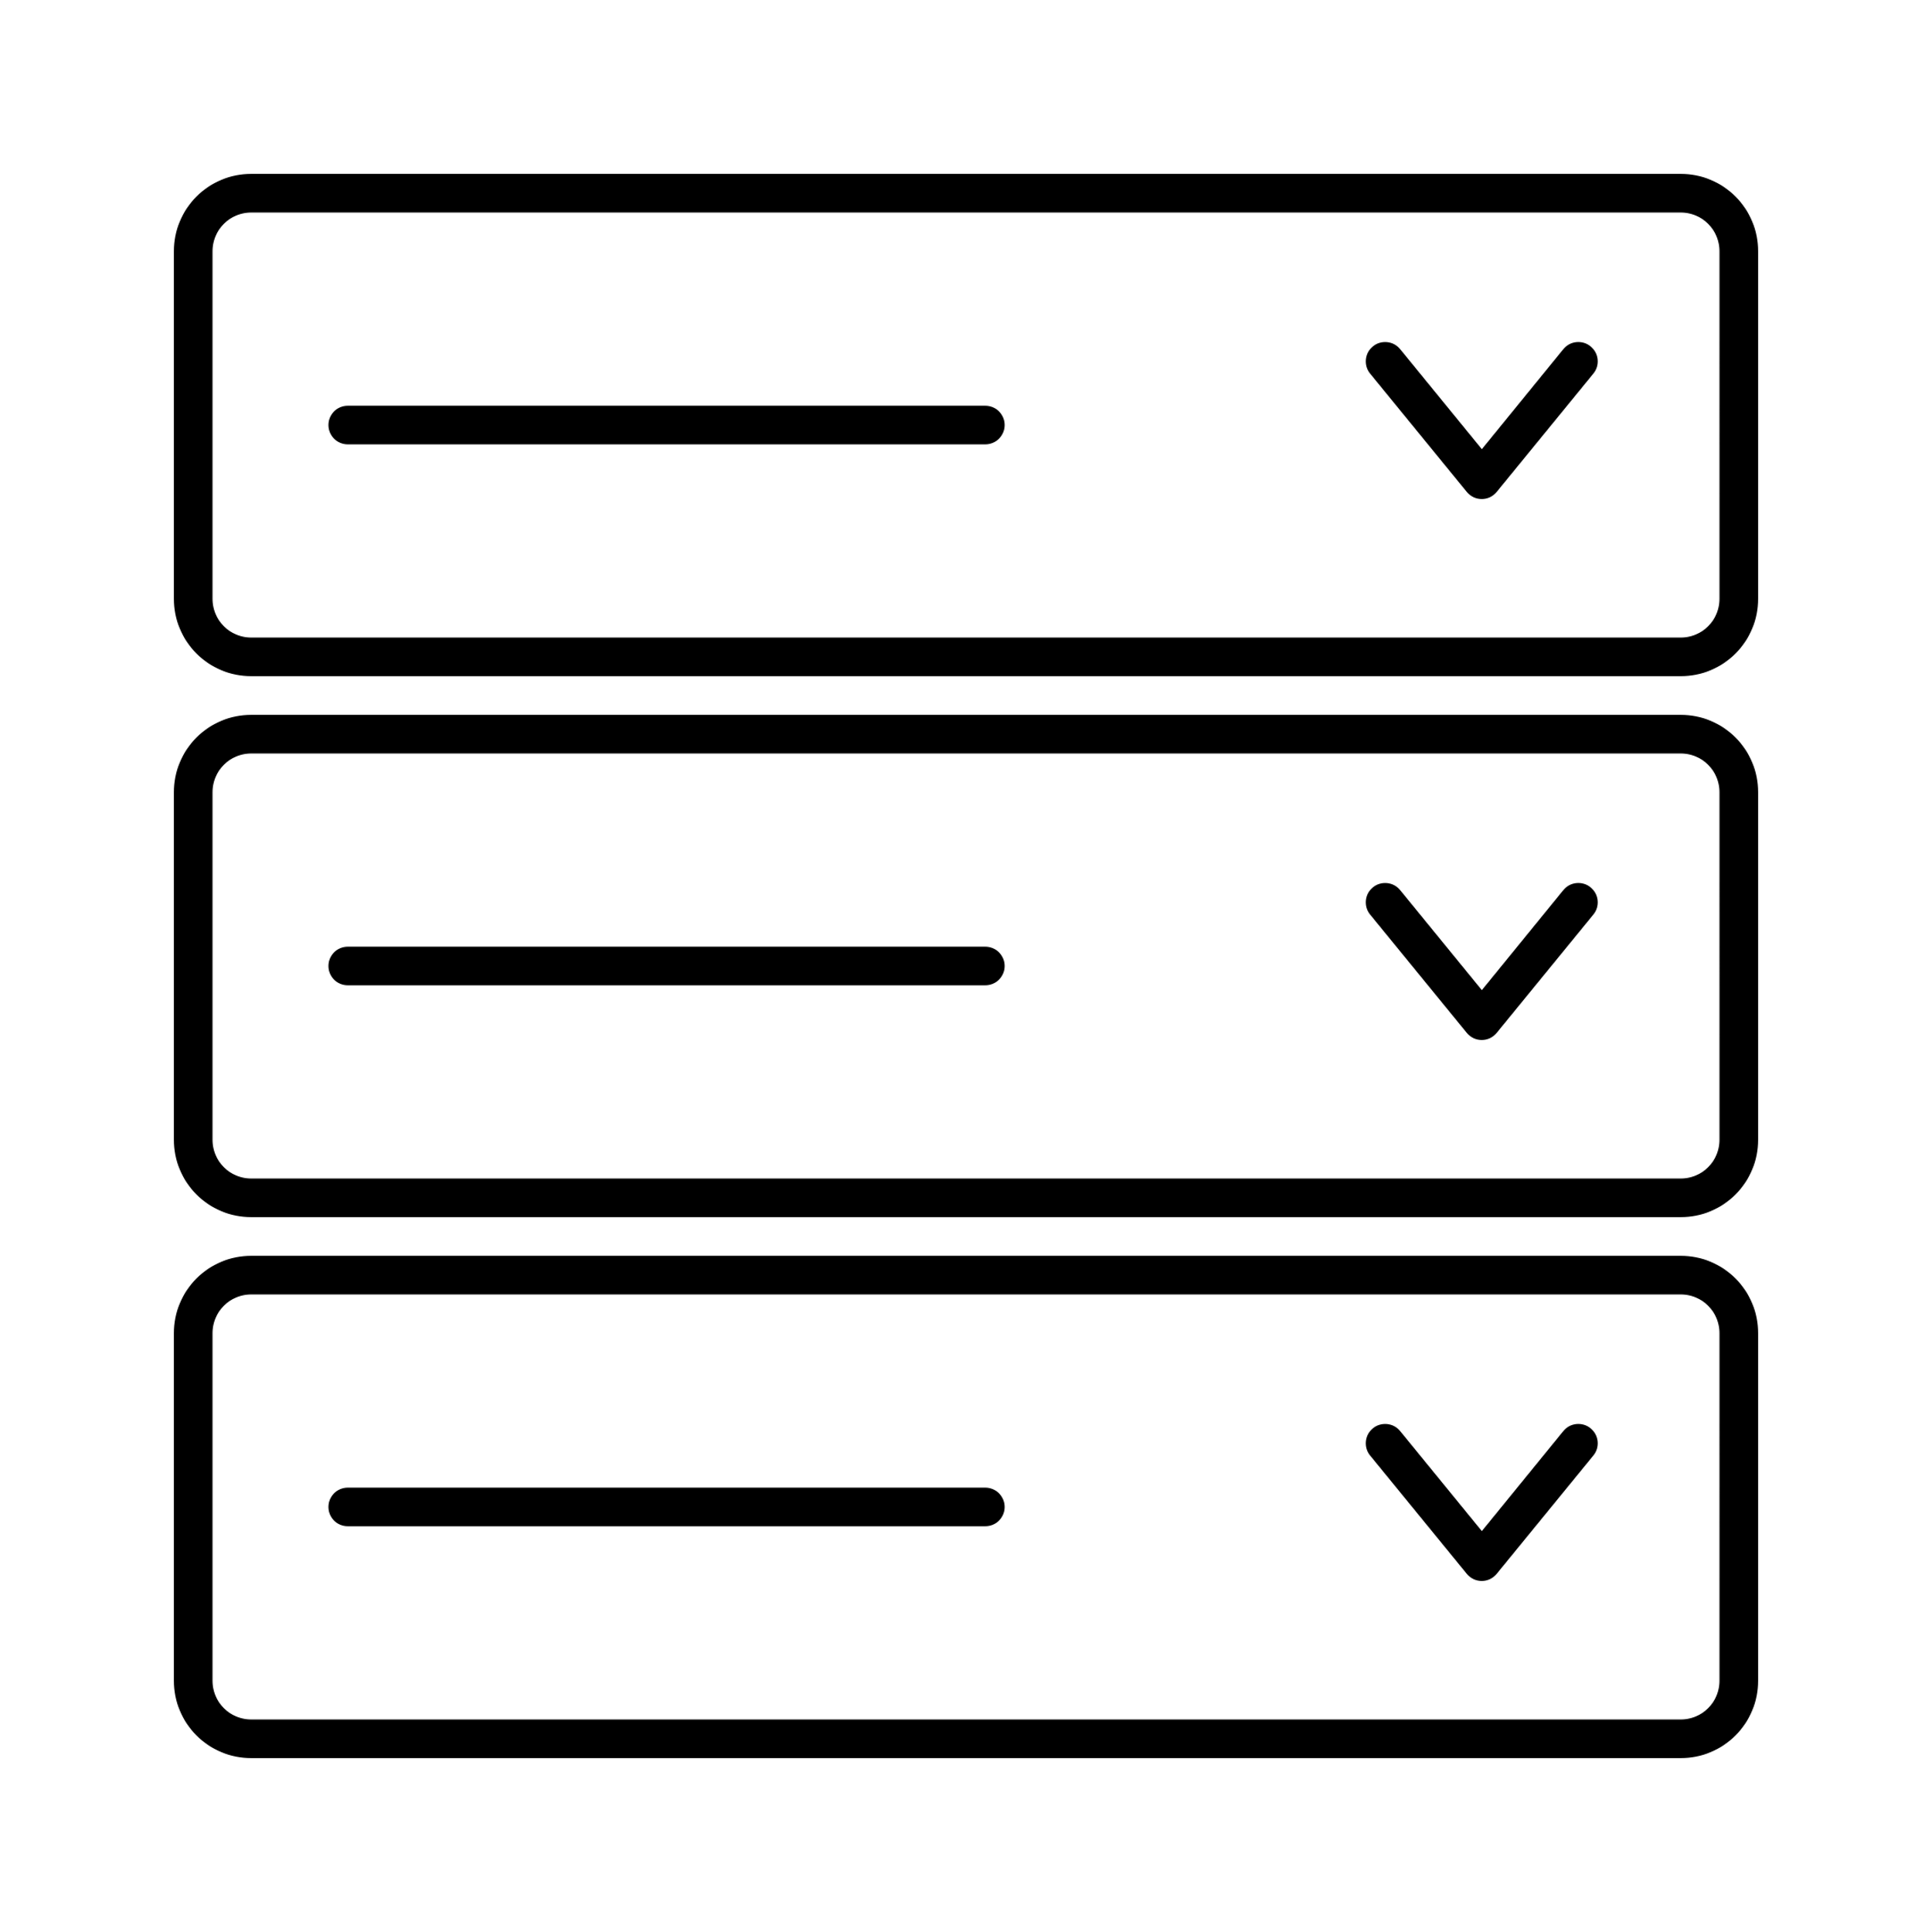
Prototyping our idea with the accordion component
We wanted to know if the content we’d developed matched up with what our users expect.
But, we didn’t want to wait until we’d designed and published this content on our site.
Notes:
So we prototyped this critical checklist idea with one of our components — the accordion component —with our initial focus on the content only.
It took us a few weeks to come up with a good draft. But we can’t launch something like this in a vacuum. Before we actually roll anything out, we need to test our ideas with our users to see if we’re on the right track.
And to talk about testing, I'd like to pass it to Jacline.
[PASS TO JACLINE]

Slide 21
Content testing: Goals
Goals
Discover
Mental models
Expectations
Evaluate
Comprehension
Tone
Gaps
Actionability
Notes:
Thanks Amy. I'm Jacline Contrino, she/her, and [self description]. As Amy said, we wanted to get our ideas in front of USWDS users before any code was written or content published on our site. So, after we created the Critical Checklist content, we made a plan to test it.
Our primary goals with the content test were pretty varied.
We wanted to discover…
Mental models and expectations: What do users think about and what do they expect when it comes to accessibility guidance? Does our content meet their expectations?
Also, we wanted to evaluate our content for…
Comprehension: How well do users understand the content we’ve created. Are there any parts that are confusing or unclear?
Tone: Is it written in plain language so that it makes sense to people?
Gaps: How complete is the content? What’s missing? Did we forget something important?
And finally, Actionability: How well does the content enable users to take action on the guidance and start doing manual accessibility testing themselves?
Next, let’s talk about our method for carrying out this study...

Slide 22
Content testing: Method
Method
4 participants
2 designers
2 developers
30-minute semi-structured interviews
Expectations
Scanning (30 sec)
Reading (7 min)
Follow-up questions
Notes:
This was a fairly lightweight study that we were able to get done — from planning to completion — within about 3 weeks.
We reached out to our design system community to invite potential testers to participate. For those that were interested, we scheduled 30 minute testing sessions.
We conducted semi-structured interviews with 4 USWDS users: 2 designers and 2 developers. In the session, we first asked them what they expect to find in an Accordion Accessibility page on our website. This would help us discover if the way they think about accordion accessibility support documentation lined up with how we were thinking about it, and where there might be any gaps.
Then, we briefly showed them the document with the content we were testing. We gave them 30 seconds to scan the document so we could get their first impressions before they spent too much time with it. Did anything right off the bat stand out to them as particularly confusing, or particularly helpful?
Then, we gave them about 7 minutes to thoroughly read through the entire document. Afterwards, we asked them follow-up questions to see what might be missing or how it could be improved to better meet their needs and expectations.

Slide 23
Questions we asked
Would you please summarize the information on that page in your own words?
What was easy or difficult to understand? Why?
What questions do you have after reading that content?
What is missing that you’d like to see/what further information do you need?
What might you change and why?
Notes:
Here’s a sample of some of the questions we asked in our sessions.
Would you please summarize the information on that page in your own words?
What was easy or difficult to understand? Why?
What questions do you have after reading that content?
…etc.
These questions helped us tease out where we might need to make improvements to our Critical Checklists.

Slide 24
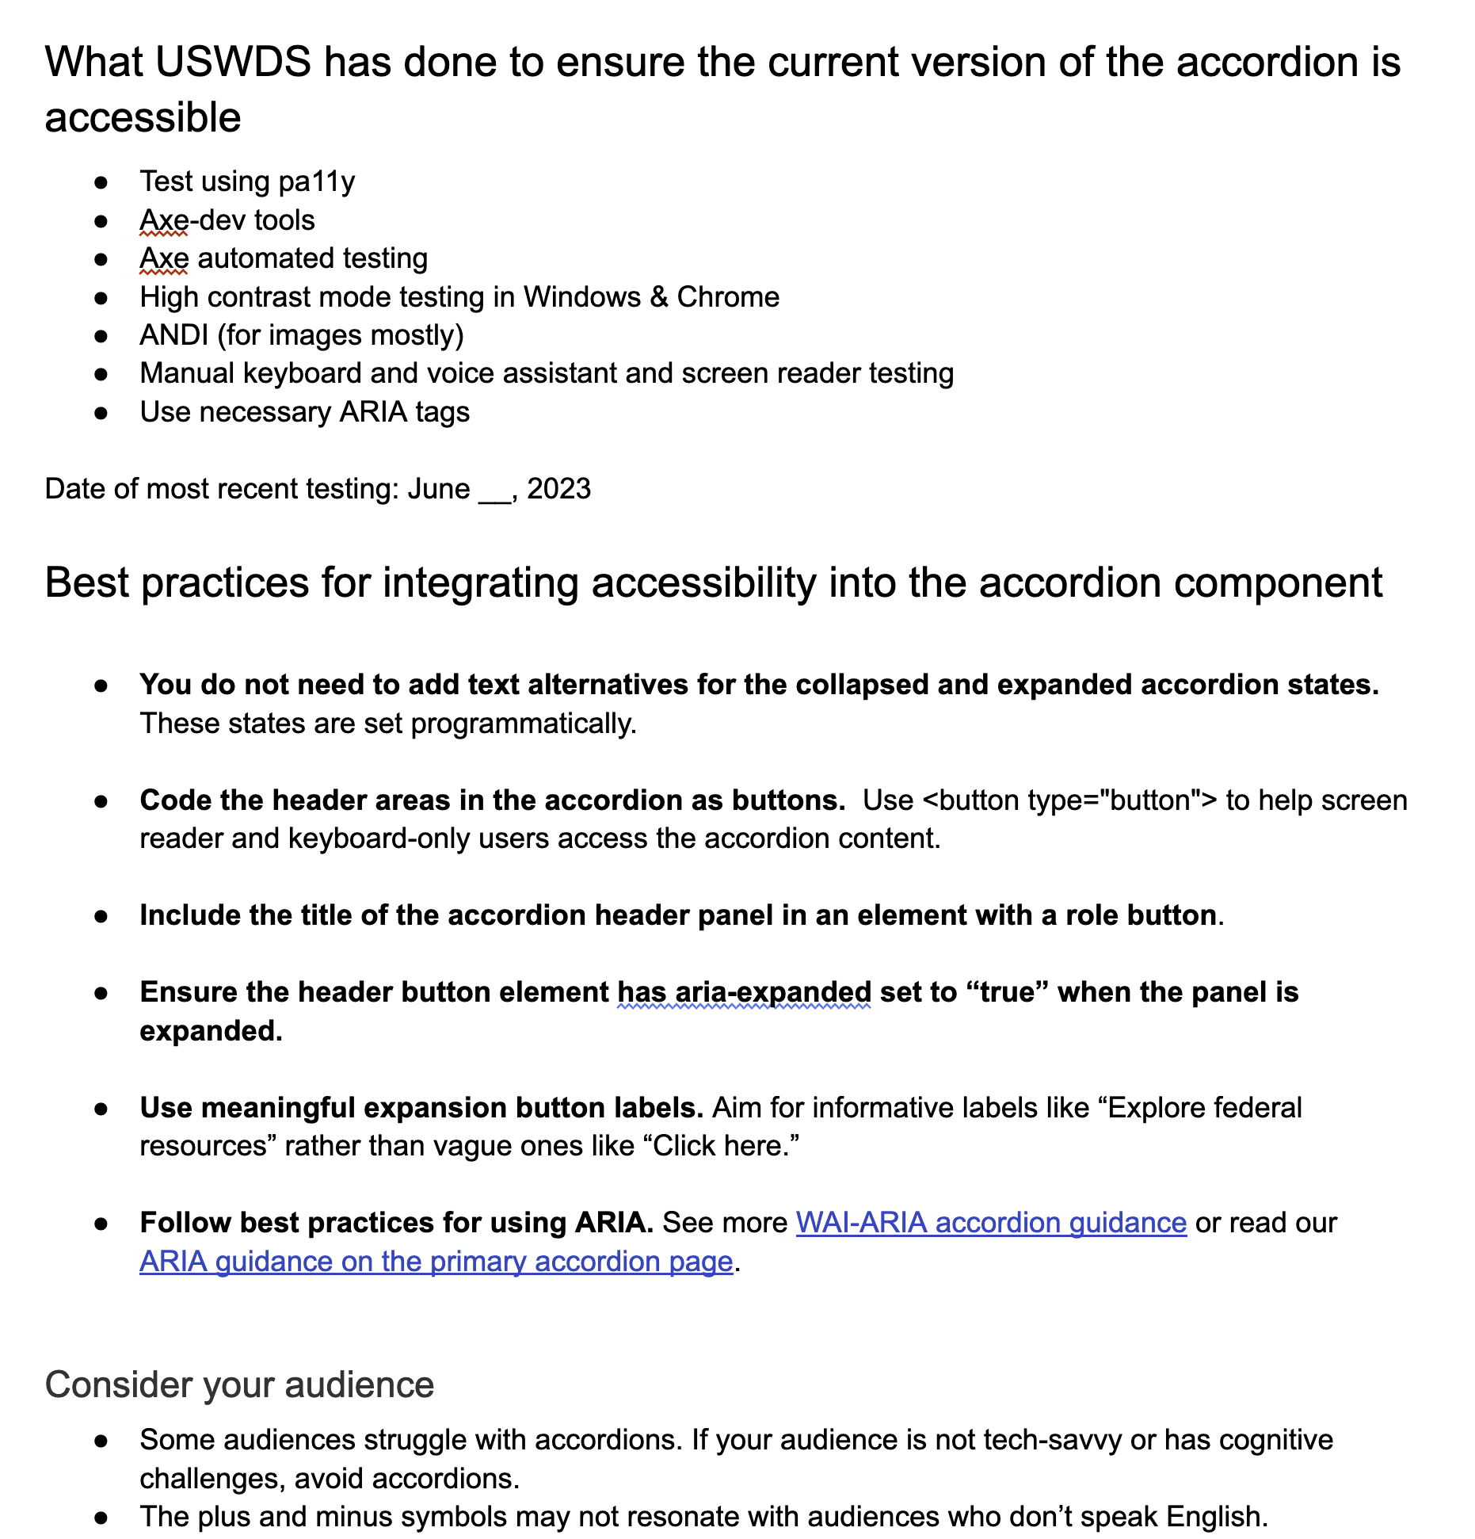
We learned we were mostly on the right track
What worked
Meets or exceeds user expectations
Increases confidence
Empowering
Comprehensive
Understandable
Notes:
Ok, so what did we learn from our content test?
We discovered that we are mostly on the right track with the content. The image on this slide shows a sample of what the Critical Checklist content looks like. The major sections shown are detailing what USWDS has done to ensure the current version of the accordion is accessible, and also gives best practices for integrating accessibility into the accordion component.
We showed this to users and learned that overall, it meets or exceeds their expectations. One person was impressed and she said, quote:
“I think that's it's hard to think of all the pieces of accessibility… and I think this does a really good job [at a] high level, considering all of the pieces and also encouraging testing. Even showing or telling them how to test, [the] tools to use. It's very well put together.”
So, participants were really excited about it and felt that it’d help them feel more confident that the accordion component checks all the accessibility boxes while also empowering them to test their own implementations.
We found that the content was also fairly complete. Overall, the document covered most of what users seemed to need.
Also, the information was understood by all participants. There weren’t too many points of confusion except for a couple of areas that needed some rewording or clarification.
Finally, users felt that it was written in plain language and not too technical, and the content flowed in a way that made logical sense to them.

Slide 25
We learned what we needed to improve
What to improve
Extensive content could be overwhelming
Clarity about responsibilities
The role of ARIA
The basics: Color contrast, font size, text length, etc.
Testing results
Notes:
So what can we improve? One opportunity for us was around learning that participants felt that the content was extensive and that it could be overwhelming. One participant said that they could see how users might get “lost” in it. And another commented, quote: “The first initial thought I had was [that] this is a lot of information. I'm not sure if it would be relevant to everyone...I don't know if [it] would be overwhelming to someone who's coming in for a quick answer.”
So that’s something we’re going to be mindful of as we move forward into designing what the content might look like on the site.
Also, we learned that some content needs clarification. For example, users weren’t clear on who was responsible for adding ARIA attributes to the code: were they already built into the component or is it something teams need to wire up in the code themselves.
And, speaking of ARIA, we had a couple of participants express some hesitancy around ARIA. In our original guidance, we encourage users to follow best practices for using ARIA. Users thought it could open a can of worms since it is easy to make errors. As one user put it “no aria is better than bad aria” and commented that we might want to put some disclaimers or words of caution around using ARIA. Going forward, we decided we’ll want to focus less on specific markup guidance and more on checking if the component is meeting certain UX outcomes. For example, does it announce when the accordion is expanded and when it is closed?
We also observed that some users want more basic, design-specific guidance, particularly on color contrasts, font sizes, and text length.
Finally, we learned that there is an appetite for more detailed information on testing results and research that we’ve done on components. Some participants wished they could click into the details of research findings. We are currently prototyping ways to better communicate research findings for components, so more to come there.

Slide 26
Clip: Clarity about responsibilities
Notes:
We wanted to show a short clip that demonstrates participant confusion around who is responsible for adding ARIA to the component.
[play clip - 27 sec]
So, speaking with our users led to some valuable insights for where to take our checklists. We will keep striving to incorporate the users’ voice in our design process, and plan to test later iterations of our checklists as well, and I’ll hand it back off to Dan, who will speak a bit more about where we are going with this project.
[PASS TO DAN]

Slide 27
What’s next?
Where are we now
Completed audit of about half of our components
Completed accessibility-focused usability testing with key components
Prototyping new content page
Where we want to go
Re-test new page content
Publish first critical checklists to our website
Augment critical checklists with key usability requirements
Broader accessibility testing
Notes:
Which brings us to what's next: where are we now, and where we're heading with our Critical Checklists.
We've completed writing checklists for and auditing about half of our components. And we've also completed accessibility-focused usability testing with key components as well. Beyond our manual testing, we've been testing the components with real users of assistive technology to catch some usability issues we might not have noticed otherwise.
And we're also prototyping a new content page to be simpler and more streamlined. We'll look at that in just a moment!
Where are we going next? Well we'll be finishing up our checklists and audits over the next couple months, as well as re-testing new page content with users. As soon as possible, we want to start publishing these critical checklists to the component pages of our website — we don't want to wait until they're all done to publish the first of them.
And we're also looking into augmenting the WCAG-based checks with key usability checks we're finding through our usability testing, to help give the fullest picture of what a component needs to do to be accessible and usable to the broadest range of people.
And to help with this, we'll keep broadening our accessibility testing and research, not only with manual accessibility testing on more devices, more assistive technology, and more bowsers, but usability research with different populations to better understand accessibility from as many perspectives as possible.
To end, I'd like to take a quick look at how we're collecting this data, and how we're prototyping its presentation…

Slide 28
What we’ve built
Demo
Notes:
[DEMO]

Slide 29
Get in touch with us!
Website and newsletter: designsystem.digital.gov
Email: uswds@gsa.gov
Slack: chat.18f.gov
Monthly calls: digital.gov
Github: github.com/uswds
Notes:
So thanks for having us here to talk about Critical Checklists for USWDS components. This is just the start of what we hope to be a useful accessibility resource for all kinds of folks interested in thinking about the accessibility of what they build. If you're here at IAAF, you're the kind of person we hope can both benefit from and influence these critical checklists. Get in touch with us, or stay in touch with us to hear more what we're up to:
Check out our website and sign up for our newsletter at designsystem.digital.gov
Send us an email at uswds@gsa.gov
Join our Public Slack channel at chat.18f.gov
Learn more about our monthly public calls at digital.gov, and…
Follow our open source public code repos at github.com/uswds.
Thank you!

