Slide 1
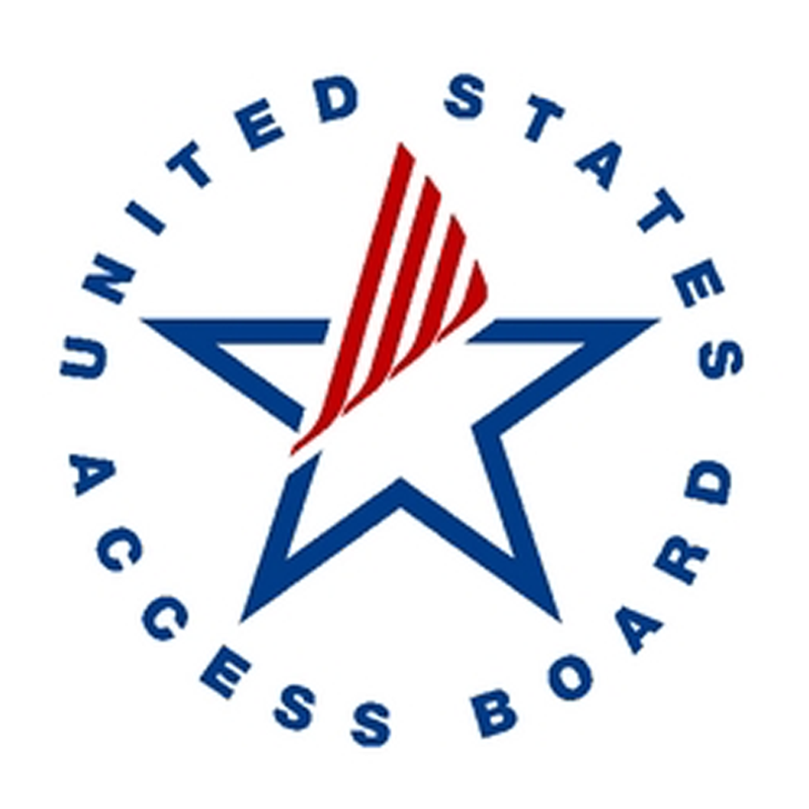
Testing for Compliance: A Comparison of Tools and Methods
Annual Interagency Accessibility Forum
November 7, 2023
Erin Elzi
Alex McNally
Office of Natural Resources Revenue

Slide 2
Overview
Who we are, what our team does, and how testing helps meet our accessibility goals
Automated versus manual accessibility testing
Our experience in using various methods
Automated methods and tools
Manual methods and tools
Comparison & Recap
Q & A

Slide 3
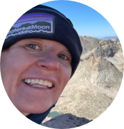
Who are we?
Open Data, Design, and Development (ODDD)
Office of Natural Resources Revenue (ONRR)
Product Manager
Maroya Faied
Customer Experience
Lindsay Goldstein
Content Strategist
Christine Thomas
Developer
Jeff Schwartz
UX Designer
Erin Elzi
UX Designer
Alexandra McNally

Slide 4
Poll #1
Who is responsible for accessibility testing for websites and web content at your agency?
A dedicated 508 person or team
Certain individuals or teams for whom accessibility is just one of their many roles
Everyone
No one
I don’t know

Slide 5
ODDD’s Accessibility Goals
Section 508 Compliance
WCAG 2.2 AAA
Score as high as possible using automated testing tools
ONRR Policy – all posted documents must be compliant
Some of these are extremely difficult to do and we might never get there. But these lofty goals work with our iterative design process.
We’re never “done.”

Slide 6
2 Testing Types
Automated
Manual
Tool dependent
Tools are quick and easy to run
Good for finding issues that might be code errors
Takes some knowledge to understand connection between the errors
Methodology dependent with tools to support it
Very time consuming
Good for finding issues that are more contextual
Easier to recognize what fixes are needed

Slide 7
Automated and Manual Options
Automated
Manual
Lighthouse
Wave
A11y
Level Access
SiteImprove
In-app checkers (Microsoft, Adobe)
CMS Widgets
Screen Readers (NVDA, Jaws,
Trusted Tester (ANDI, ACRT)
Bespoke

Slide 8
Chat Question #1
What automated or manual methods and tools are you using?

Slide 9
Automated Testing: Lighthouse
Free
Runs on a single page
Can check for more than accessibility
Can be integrated into CircleCI
Details where the detected failures are located
Provides a list of some manual things to check

Slide 10
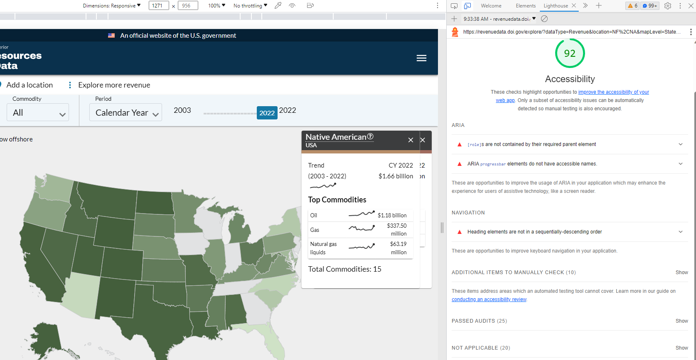
Example: Lighthouse in Dev Tools

Slide 11
Automated Testing: WAVE
Free
Tests single page at a time - not a whole site
WAVE website tool allows users to simply enter URL
WAVE extension tool in Chrome browser
Tutorial videos for training
Checks for compliance with many WCAG 2.0 guidelines
Cannot review logical flow of content meaning, tab order logic, functional keyboard access, and alternative text meaning

Slide 12
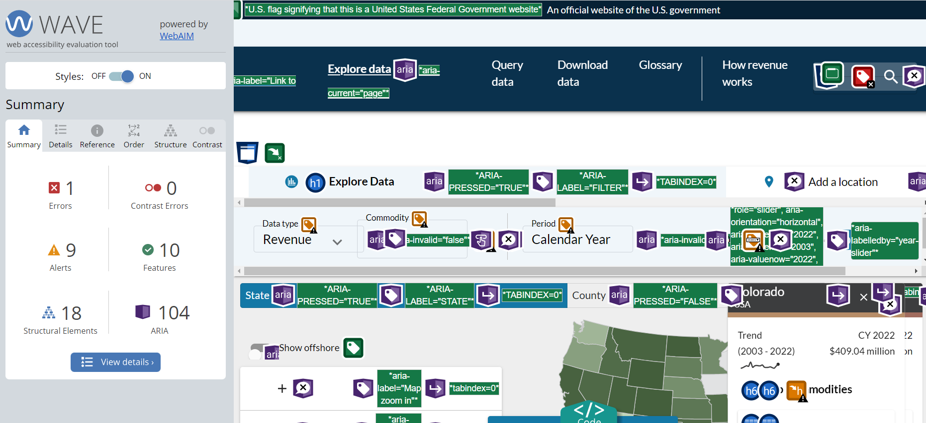
Automated Testing: WAVE Chrome Extension

Slide 13
Automated Testing: Level Access
Subscription/paid for
Can run for an entire site or specific pages
Training videos and documents available
Different levels of account access to view or run reports
Prioritizes issues based on occurrence and how likely a user is to encounter the problem
Access Assistant extension

Slide 14
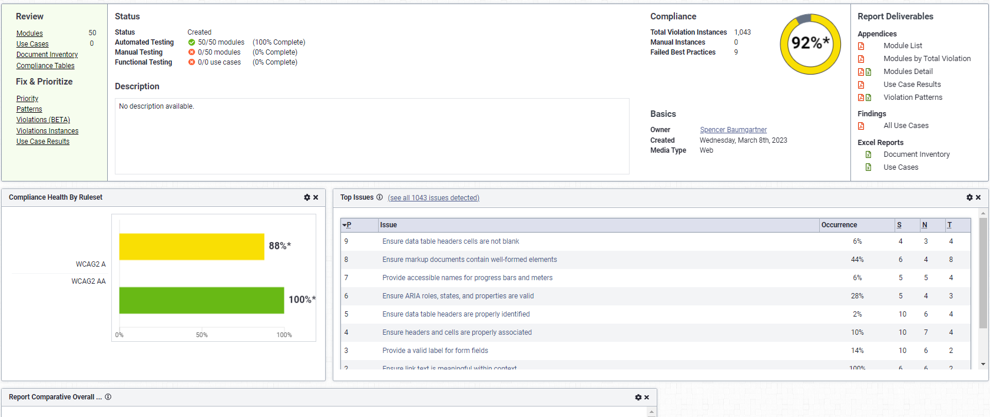
Example: Level Access

Slide 15
Automated Testing: Access Assistant (Level Access)
Free
Run specific pages
Can be connected to your Level Access AMP reports (but not required)
Quick and easy way to check fixes from issues found by Level Access
Directs to the violation instance

Slide 16
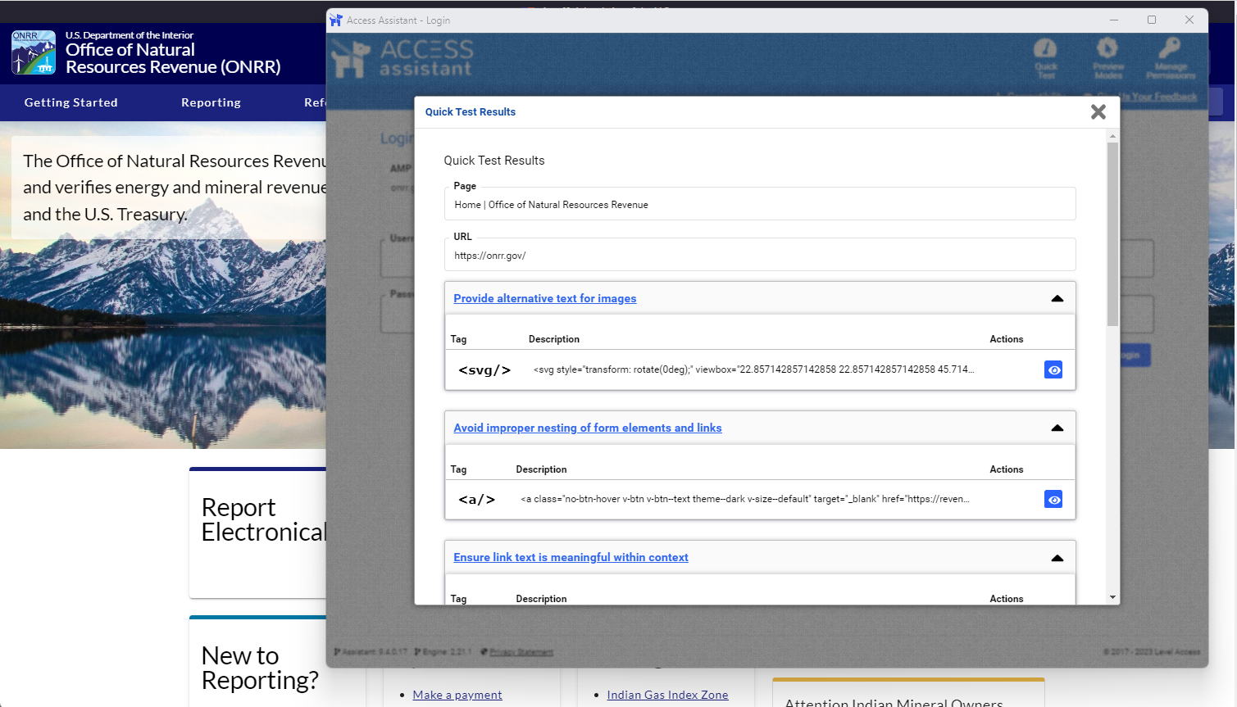
Example: Access Assistant (Level Access)
This page scores 100 in Lighthouse, but Access Assistant finds 16 instances of 4 violations

Slide 17
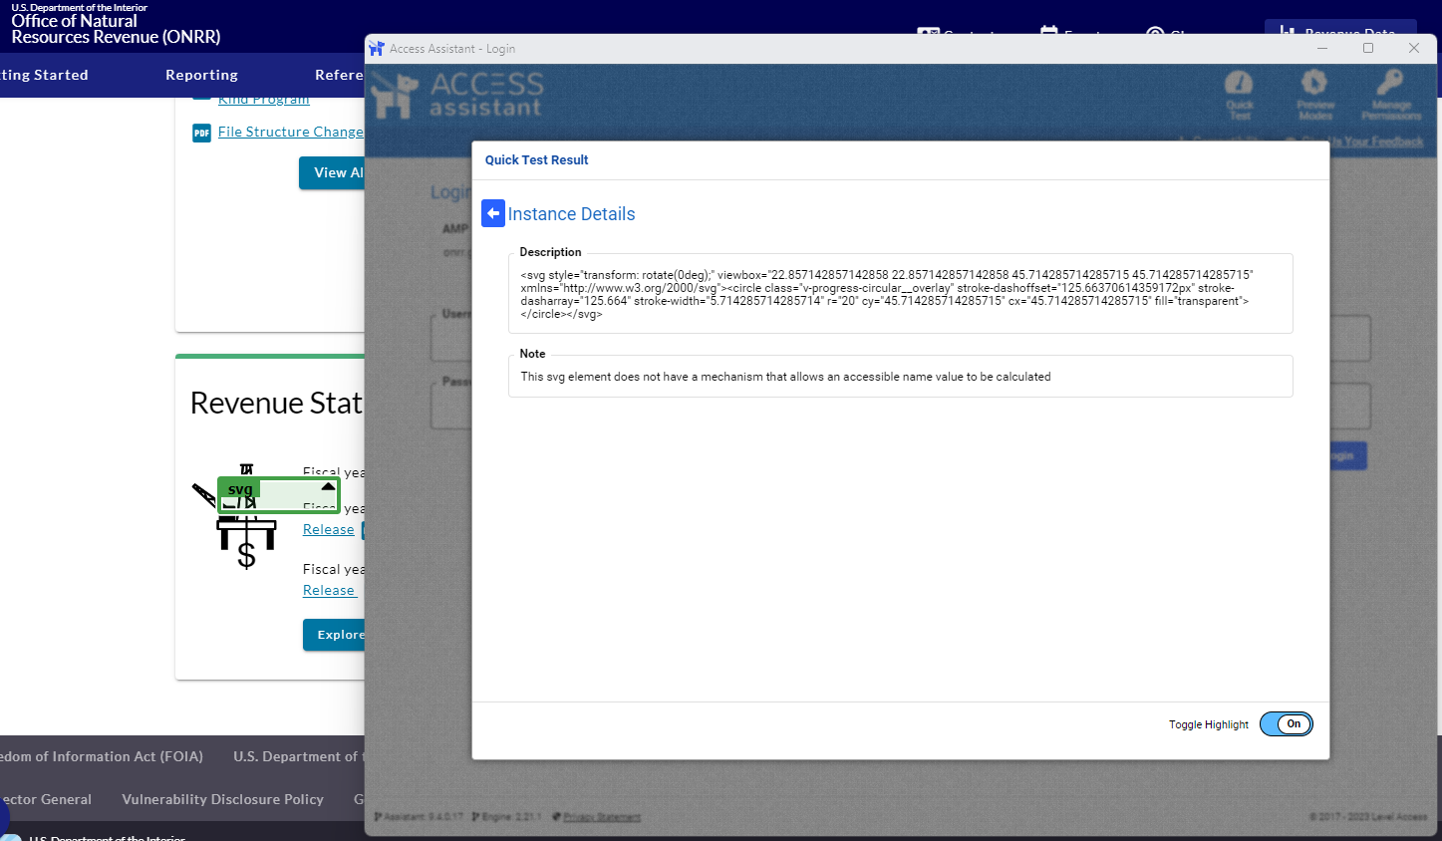
Example: Access Assistant (Level Access), continued
Clicking on the eye icon in the quick test results takes you directly to the issue and highlights the issue in green.

Slide 18
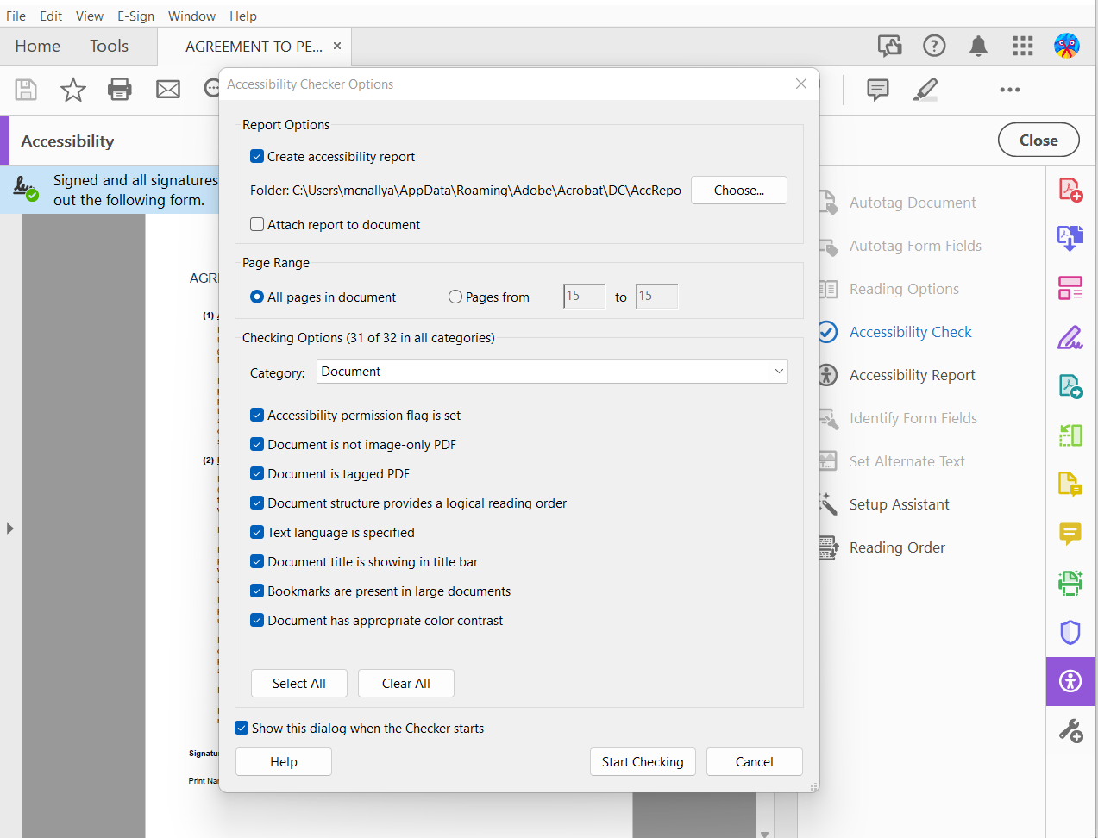
Automated Testing: PDFs
Run an accessibility check that reviews tags, structure, alt text, titles, bookmarks, etc.
Creates accessibility reports
Manual checks required for reading order, color contrast, etc.
In-app (Adobe, ABBYY) or free (PAC 2021)

Slide 19
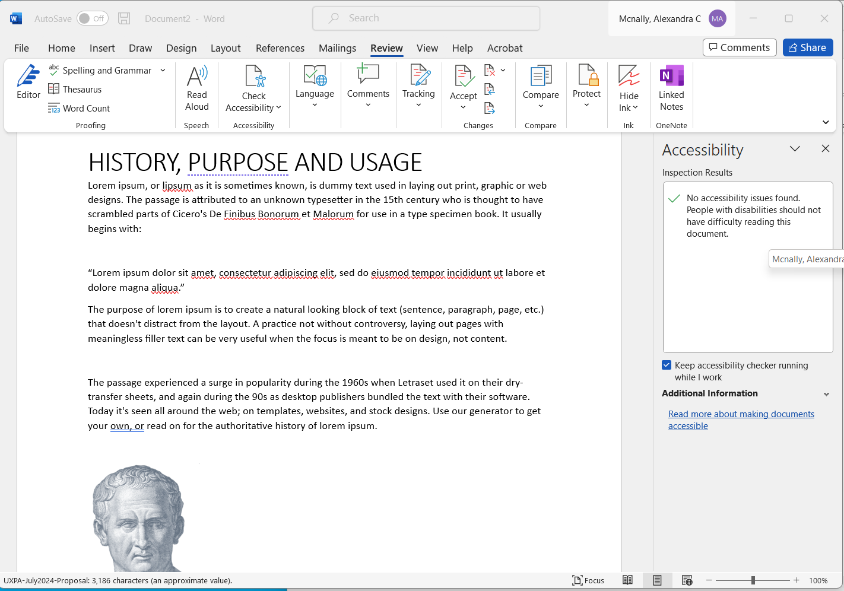
Automated Testing: Non-PDF documents
Microsoft and Google both have in-app accessibility checkers
What it checks depends on the app and document type
Detects major accessibility issues: text and heading hierarchy, alternative text, color contrast, etc.

Slide 20
Manual Testing: Screen Readers
NVDA
Jaws
Free
Opensource; continuous community improvement
Use on Windows OS
Output text as audio or braille
Best on Chrome & Firefox
More widely used – better for understanding UX
Paid-for
Licensing is only for a specific version; fixes/updates are added costs
Use on Windows OS
Output text as audio or braille
Best on Chrome & Firefox
Browse mode - preferred for testing and audits
Better training and support
More customizable
Industry standard

Slide 21
Manual Testing: Trusted Tester
Uses ANDI and ACRT
Very comprehensive (and very time-consuming)
Single-page
62 criteria
Contextual
Also tests for many issues found by automated testing
Lengthy training and certification process
ODDD blog post: Advanced Section 508 Compliance Testing
Managed by the Department of Homeland Security
Free
Training not required, but we highly recommend it

Slide 22
Manual Testing: ANDI
Free
Opensource
Bookmarklet
Developed by US Social Security Administration
Sometimes firewalls prevent the use on browsers, so requires certain approvals by IT groups
Results for an audit can be tracked in ACRT

Slide 23
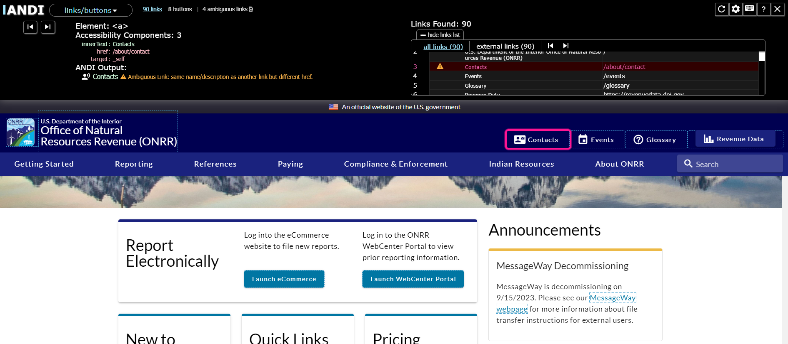
Example: ANDI

Slide 24
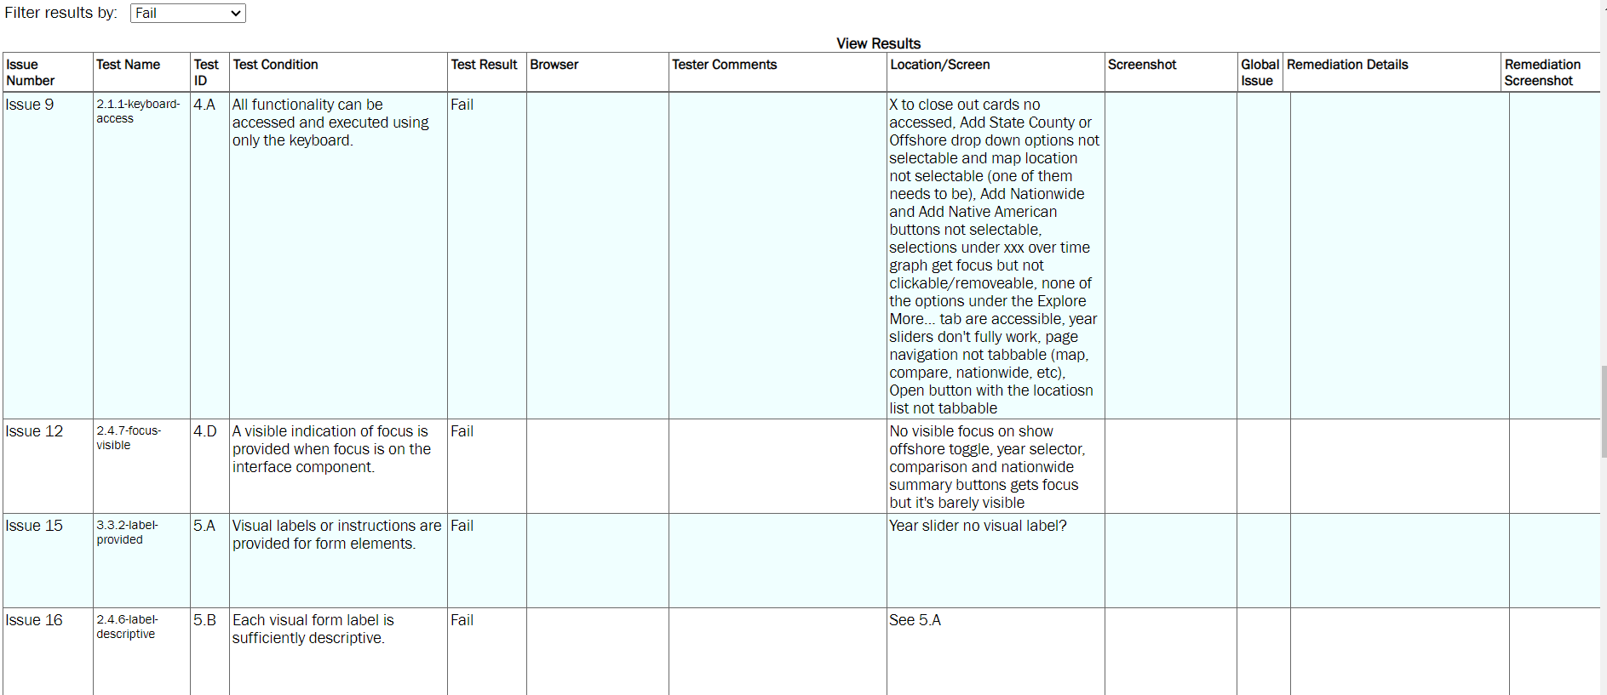
Example: ACRT

Slide 25
Manual Testing: Bespoke
Cost is variable, may depend on in-house expertise
Meets specific needs of agency or company
Potentially time consuming (large lift)
Potential tasks related to manual testing:
Research of accessibility challenges and best practices
Evaluate website or webpage against these researched accessibility elements
Prioritize with list of inaccessible website/webpage attributes
Fix identified attributes

Slide 26
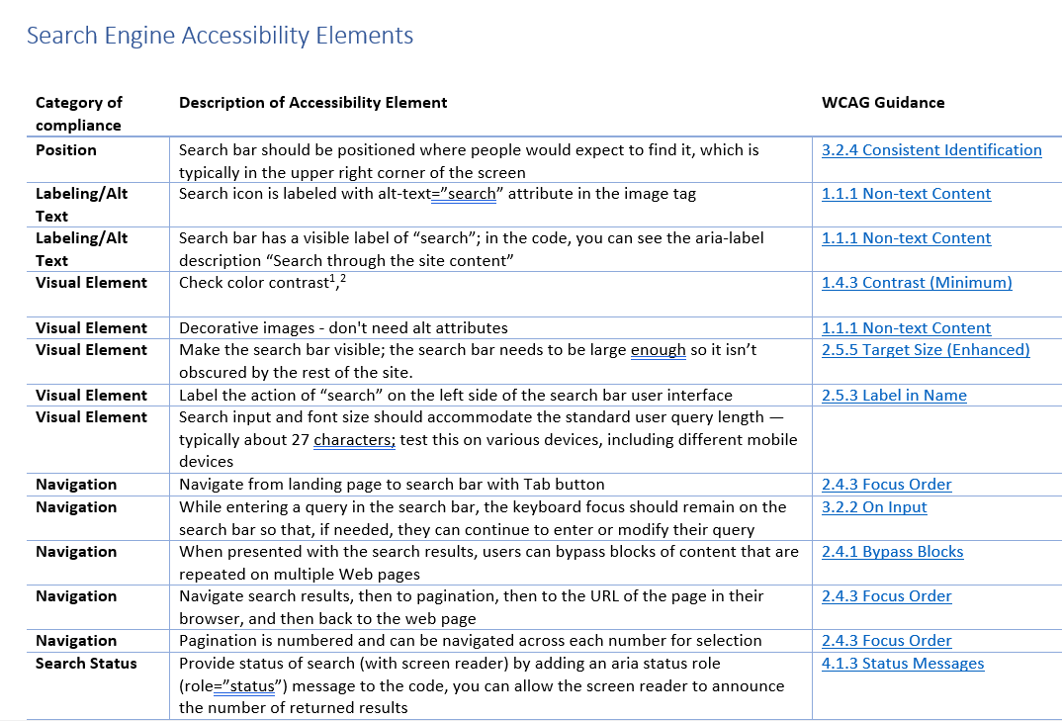
Criteria: Bespoke
Using WCAG Guidance, we created our own set of criteria for an accessible search function

Slide 27
Findings: What each tool/method does and does not find
https://docs.google.com/spreadsheets/d/1ipD1wxFH4TsPN4ZAb7ZJhKhufvefEV5HEGdH0IeVQEI/edit?usp=sharing
Let's work together and make this a useful, living document!
Feel free to add comments on things we should change or add.

Slide 28
Automated Comparison: Lighthouse, Level Access, Wave
Lighthouse
Level Access
Wave
Free
Runs on a single page
Can check for more than accessibility
Can be integrated into CircleCI
Details where the detected failures are located
Provides a list of some manual things to check
Free
Run specific pages
Can be connected to your Level Access AMP reports (but not required)
Quick and easy way to check fixes from issues found by Level Access
Directs to the violation instance
Free
Tests one single page at a time - not a whole site
WAVE website tool + Chrome extension tool
Tutorial videos for training
Checks for compliance with many WCAG 2.0 guidelines
Cannot review logical flow of content meaning, tab order logic, functional keyboard access, and alternative text meaning

Slide 29
Manual Comparison: Trusted Tester, NVDA, Bespoke
Trusted Tester
NVDA
Bespoke
Comprehensive
Time consuming
Single-page
Contextual
Also tests for many issues found by automated testing
Heavy learning curve
Lengthy training and certification process
Free
Opensource; continuous community improvement
Single-page
Use on Windows OS
Output text as audio or braille
Best on Chrome & Firefox
Heavy learning curve
Cost is variable, may depend on in-house expertise
Meets specific needs of agency or company
Potentially time consuming (large lift)
Potential tasks include: research, evaluate, prioritize, fix

Slide 30
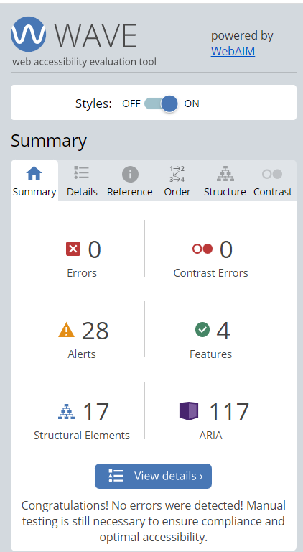
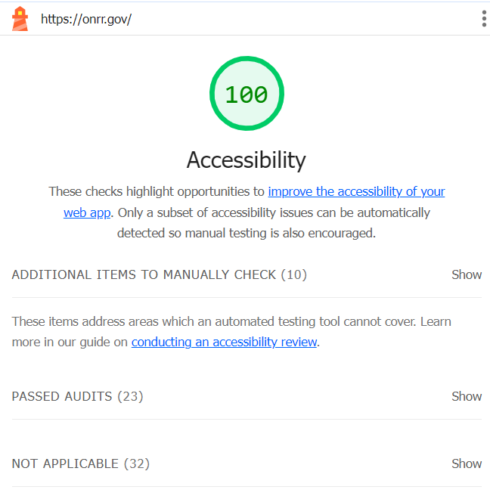
Automated Comparison: onrr.gov homepage
Lighthouse
Level Access
Access Assistant
Wave
100%
23 passed audits
16 instances of 4 violations
Zero errors, 28 alerts

Slide 31
Manual Comparison: onrr.gov homepage
Trusted Tester
NVDA
Bespoke
6 violations found
13 instances
ACRT Risk Score: 5
2 violations found
13 instances
4 violations found

Slide 32
Onrr.gov homepage issues found
Level Access
Access Assistant
Trusted Tester
NVDA
Missing alt text
Improper nesting of form elements & links
Link text must be meaningful in context
Invalid Aria roles, states, and properties
Missing visible focus
Link purpose (meaningful link text)
Decorative images have meaningful alt text
Missing bypass function
Contrast
CSS positioning
Link purpose (meaningful link text)
Missing bypass function

Slide 33
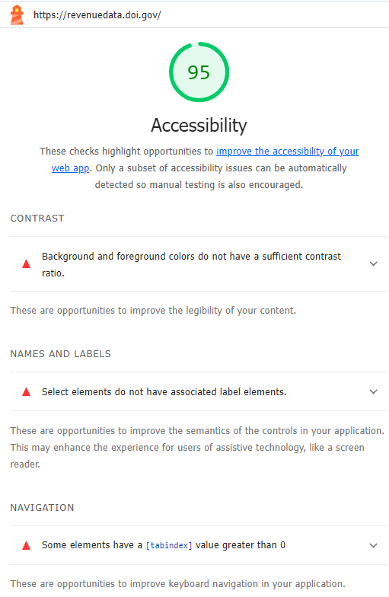
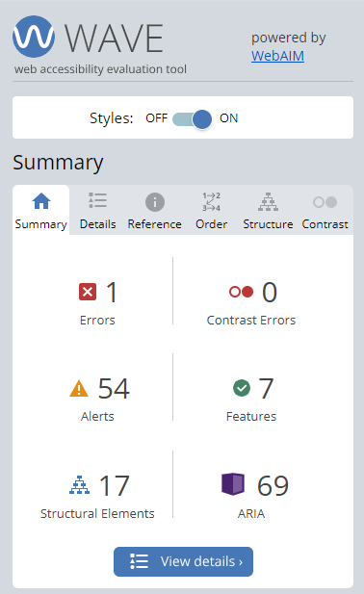
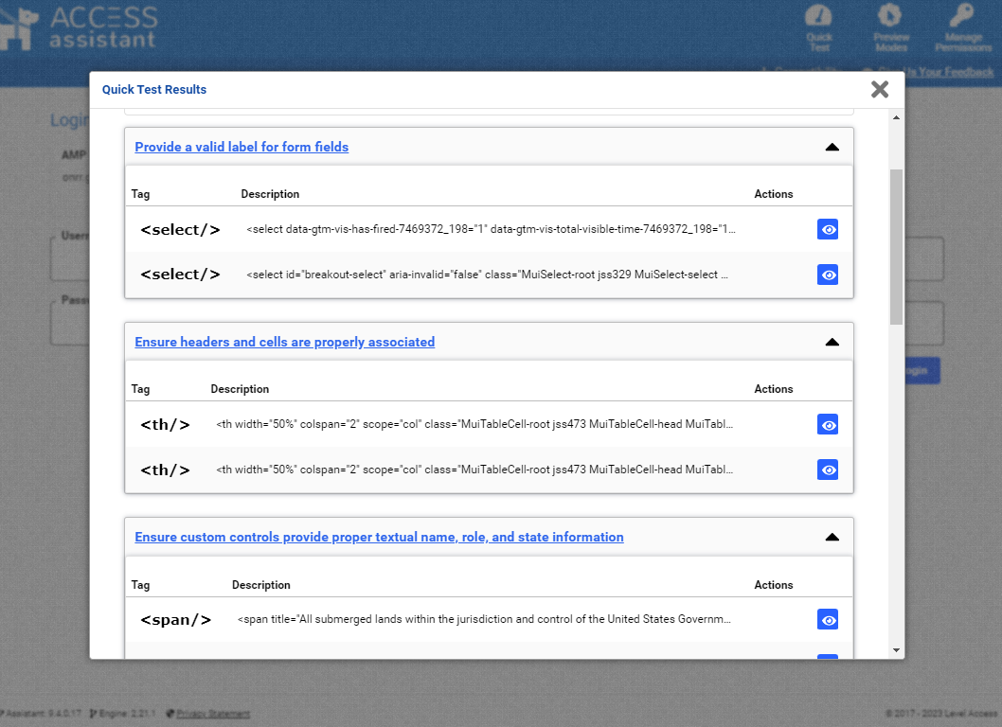
Automated Comparison: revenuedate.doi.gov homepage
Lighthouse
Level Access
Access Assistant
Wave
95%
6 instances of 3 violations
20 instances of 7 violations
1 errors, 54 alerts

Slide 34
Manual Comparison: revenuedata.doi.gov homepage
Trusted Tester
NVDA
11 violations found
24 instances
ACRT Risk Score: 7
3 violations found
4 instances

Slide 35
Revenuedate.doi.gov homepage issues found
Level Access
Access Assistant
Trusted Tester
Lighthouse
Valid label for form fields
Tables: Headers and cells must be properly associated
Layout tables must be tagged as presentation
Custom controls must provide proper textual name, role, and state info
Link purpose (meaningful link text)
Mark-up document elements
Avoid use of placeholder values to label or explain input
Keyboard navigation
Missing visible focus
Focus order
Guidance to correct form field errors
Link purpose (meaningful link text)
Missing alt text
Decorative images have meaningful alt text
Heading levels
List type
Contrast
Tables: cells associated with headers
Valid label for form fields
Contrast
Navigation: tabindex greater than zero

Slide 36
What do we do with our results?
Perform automated and manual accessibility tests
Create and prioritize issues in GitHub based on impact.
Assign issues to individuals who have the time and skills to address the issues
Use single-page level tools to check fixes
Complete issues and then run additional checks semi-regularly to continually monitor and improve accessibility
Aligns with the Government-Wide Section 508 Assessment

Slide 37
Chat Question #2
After today, what is one thing you are going to do to improve your accessibility testing process?
(It doesn’t have to be something from this session)

Slide 38
Questions?
Erin Elzi
erin.elzi@onrr.gov
Alex McNally
Alexandra.mcnally@onrr.gov
ODDD
onrrweb@onrr.gov

